Slide 1

18ECE340T- MACHINE PERCEPTION WITH COGNITION
UNIT-3
Session-4
Topics Covered: Texture Analysis using Oriented Pyramids and Laplacian Pyramids
Reference Book
Computer and Machine Vision by E.R.Davies
Prepared by
Dr. C.VIMALA
Assistant Professor/ ECE

Slide 2
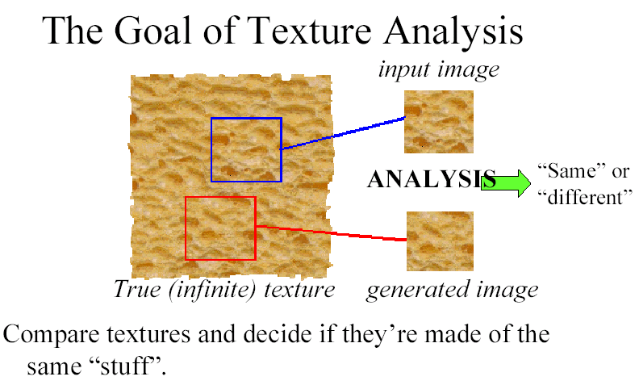
Objectives: 1) Discrimination/Analysis
Slide credit: Freeman

Slide 3
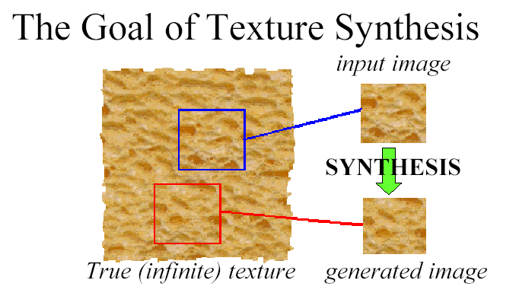
2) Synthesis
Slide credit: Freeman

Slide 4
Representing textures
Observation: textures are made up of subelements, repeated over a region with similar statistical properties
Texture representation:
find the subelements, and represent their statistics
What filters can find the subelements?
Human vision suggests spots and oriented filters at a variety of different scales
What statistics?
Mean of each filter response over region
Other statistics can also be useful

Slide 5
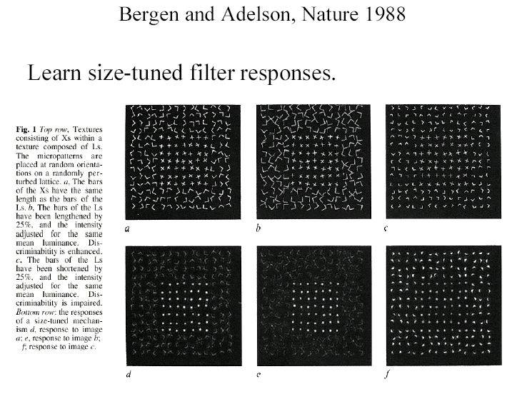
Human texture perception

Slide 6
Derivative of Gaussian Filters
Measure the image gradient and its direction at different scales (use a pyramid).

Slide 7
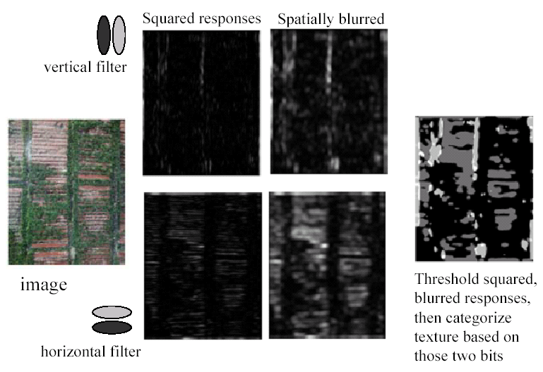

Slide 8
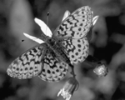
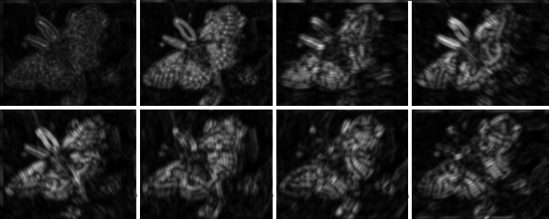
Add more oriented filters
(Malik & Perona, 1990)
Notes:
‹#›
Spots and bars at a fine scale for the butterfly; images show squared response for
corresponding filter

Slide 9
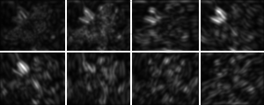
Notes:
‹#›
I’ve scaled up the coarse scale responses so they can be compared. Notice that these
representations don’t respond uniquely --- i.e. there isn’t one peak at one orientation and
one scale for a given bar --- but they do give quite a good idea of what is there. If they
were tightly tuned, there would have to be a lot more filters. But looking at these pix
gives quite a good idea of where there are big bars, where there are little ones, and
at what orientation.

Slide 10












Alternative: Gabor filters
Gabor filters: Product of a Gaussian with sine or cosine
Top row shows anti-symmetric
(or odd) filters, bottom row the
symmetric (or even) filters.
No obvious advantage to any one type of oriented filters.
Notes:
‹#›
Gabor filters are just another way to generate spots and bars.

Slide 11
The Laplacian Pyramid
Building a Laplacian pyramid:
Create a Gaussian pyramid
Take the difference between one Gaussian pyramid level and the next (before subsampling)
Properties
Also known as the difference-of-Gaussian function, which is a close approximation to the Laplacian
It is a band pass filter - each level represents a different band of spatial frequencies
Reconstructing the original image:
Reconstruct the Gaussian pyramid starting at top layer

Slide 12
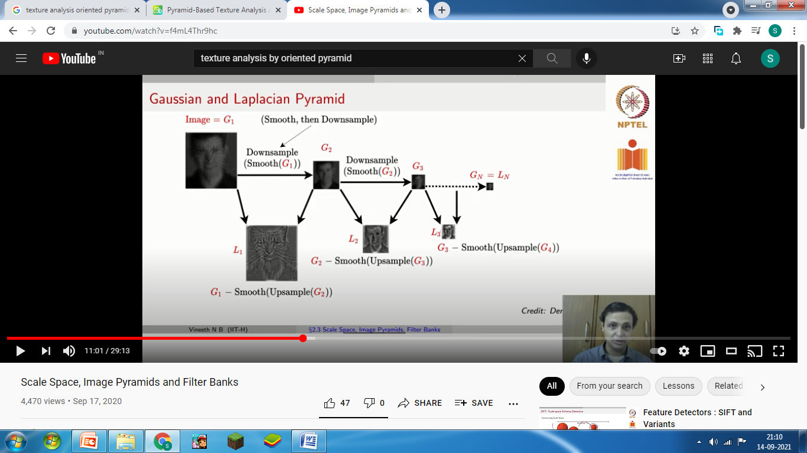
Laplacian and Gaussian pyramid

Slide 13
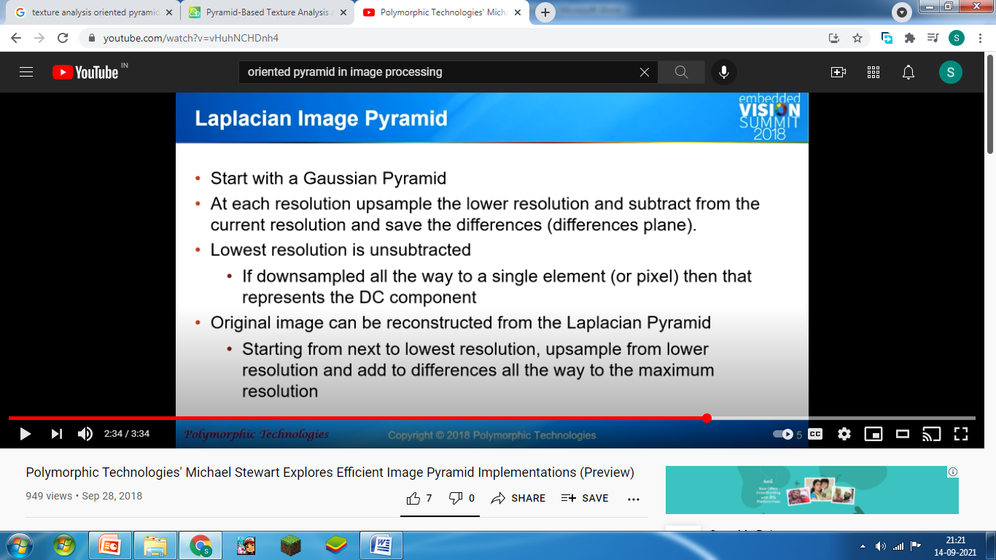
Laplacian pyramid:

Slide 14
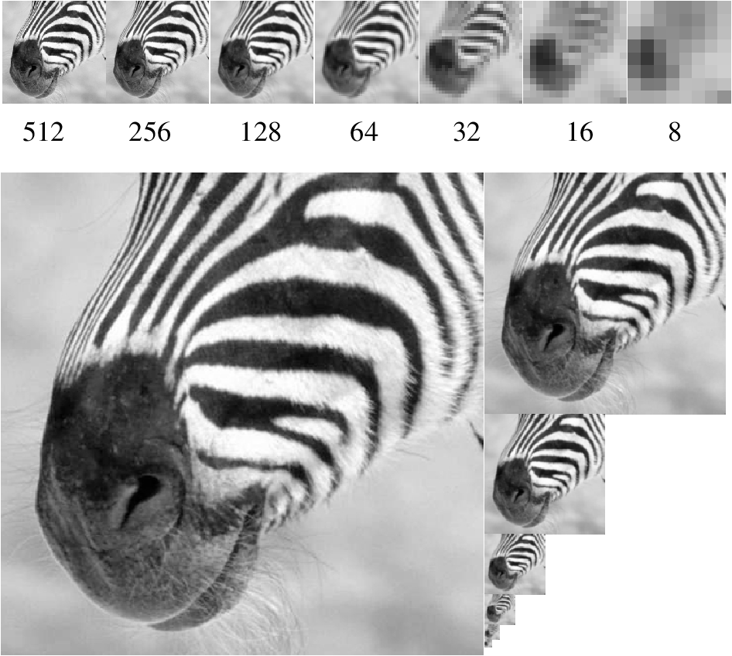
Gaussian
pyramid
Notes:
‹#›
This is a Gaussian pyramid

Slide 15
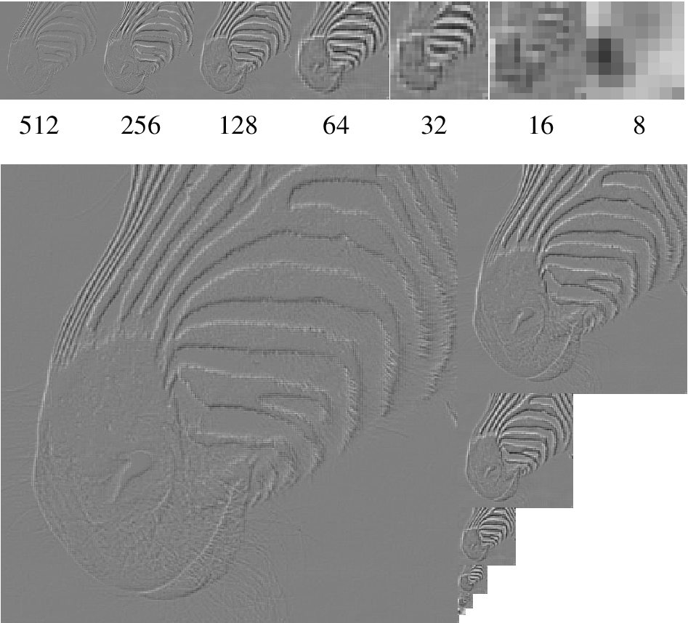
Laplacian
Pyramid
(note top image
is from Gaussian)
Notes:
‹#›
And this a Laplacian pyramid. Notice that the lowest layer is the same in each case,
and that if I upsample the lowest layer and add to the next, I get the Gauss layer.
Notice also that each layer shows detail at a particular scale --- these are, basically, bandpass filtered versions of the image.

Slide 16
Oriented pyramids
Laplacian pyramid is orientation independent
Apply an oriented filter to determine orientations at each layer
This represents image information at a particular scale and orientation.
We will not study details in this course.

Slide 17
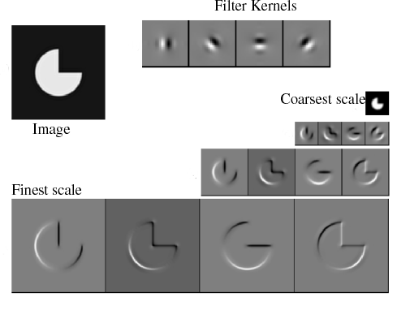
Reprinted from “Shiftable MultiScale Transforms,” by Simoncelli et al., IEEE Transactions
on Information Theory, 1992, copyright 1992, IEEE
Notes:
‹#›
This is an example with four orientations at each layer

Slide 18
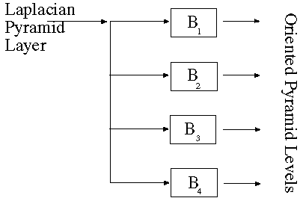
Creating oriented pyramid

Slide 19
Final texture representation
Form a Laplacian and oriented pyramid (or equivalent set of responses to filters at different scales and orientations).
Square the output (makes values positive)
Average responses over a neighborhood by blurring with a Gaussian
Take statistics of responses
Mean of each filter output
Possibly standard deviation of each filter output

Slide 20
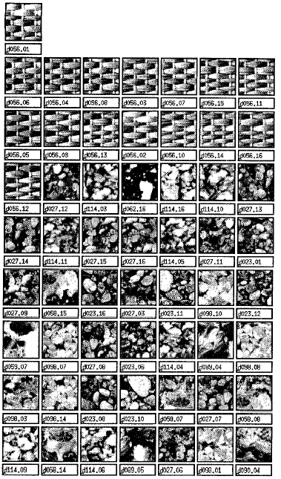
Application: Texture-based Image Matching
Decreasing
response
vector
similarity
Query image
Ordered list of
best matches
from Forsyth & Ponce

Slide 21
The texture synthesis problem
Generate new examples of a texture.
Original approach: Use the same representation for analysis and synthesis
This can produce good results for random textures, but fails to account for some regularities
Recent approach: Use an image of the texture as the source of a probability model
This draws samples directly from the actual texture, so can account for more types of structure
Very simple to implement
However, depends on choosing a correct distance parameter

Slide 22
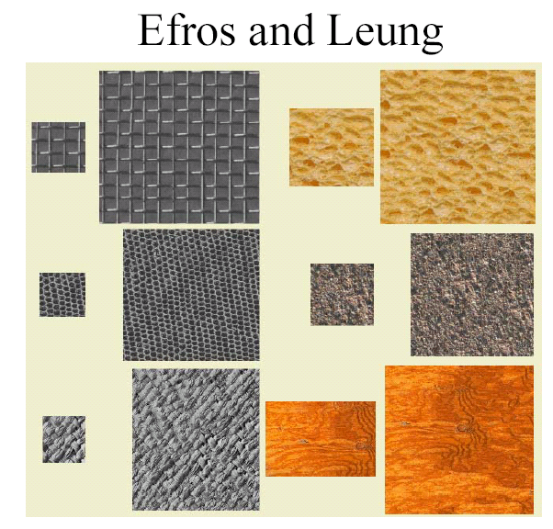

Slide 23
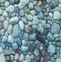
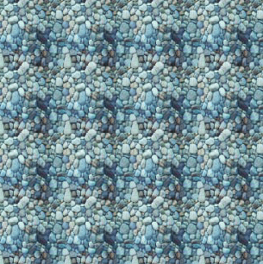
This is like copying, but not just repetition
Photo
Pattern Repeated

Slide 24
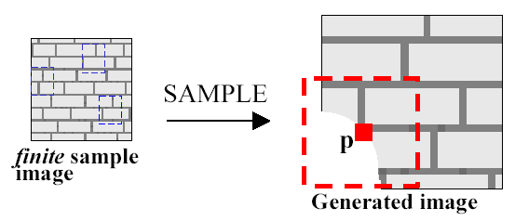
Efros and Leung method
For each new pixel p (select p on boundary of texture):
Match a window around p to sample texture, and select several closest matches
Matching minimizes sum of squared differences of each pixel in the window (Gaussian weighted)
Give zero weight to empty pixels in the window
Select one of the closest matches at random and use its center value for p

Slide 25
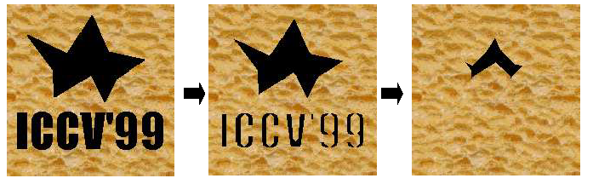
Initial conditions for growing texture
If no initial conditions are specified, just pick a patch from the texture at random
To fill in an empty region within an existing texture:
Grow away from pixels that are on the boundary of the existing texture

Slide 26
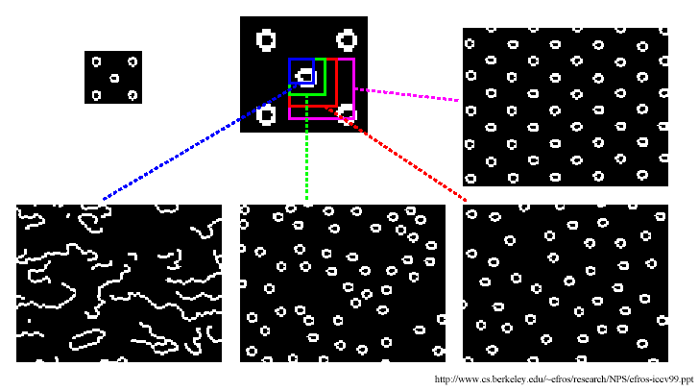
Window size parameter

Slide 27
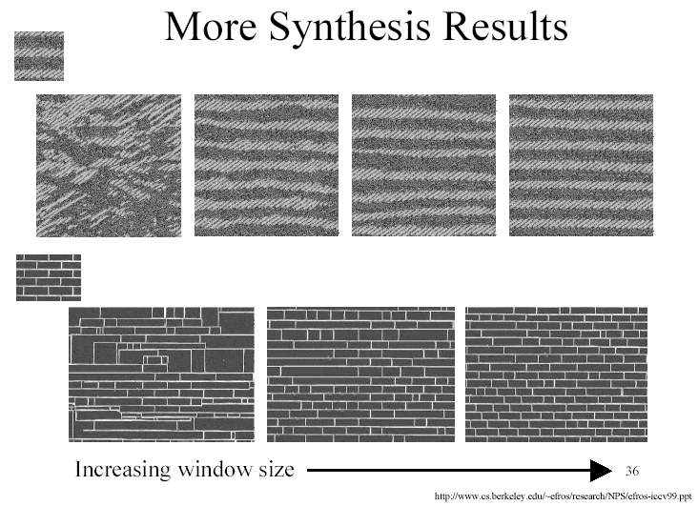

Slide 28
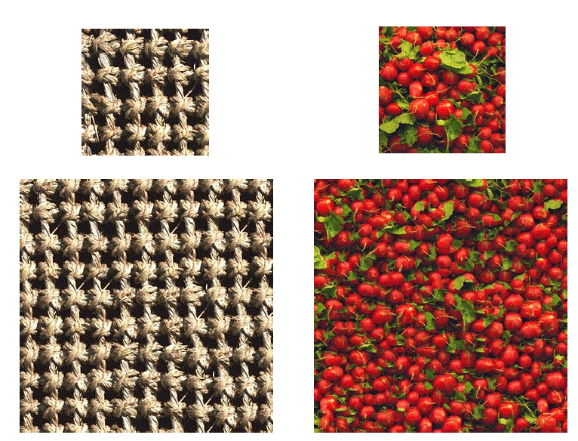

Slide 29
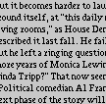
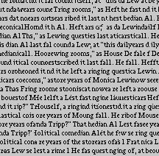
Figure from Texture Synthesis by Non-parametric Sampling, A. Efros and T.K. Leung, Proc. Int. Conf. Computer Vision, 1999 copyright 1999, IEEE

Slide 30
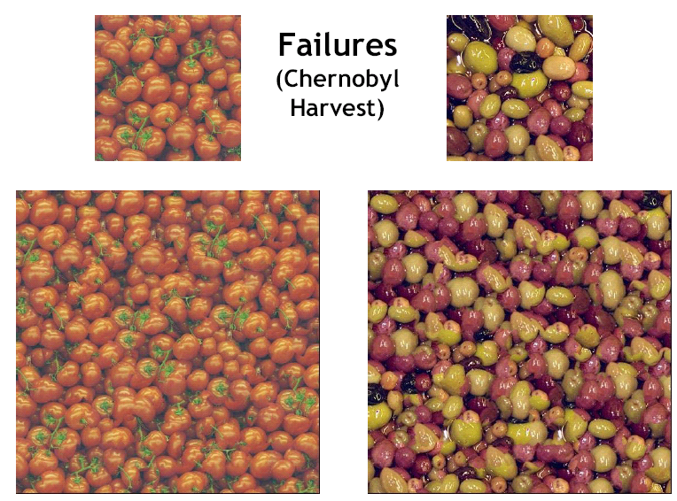

Slide 31
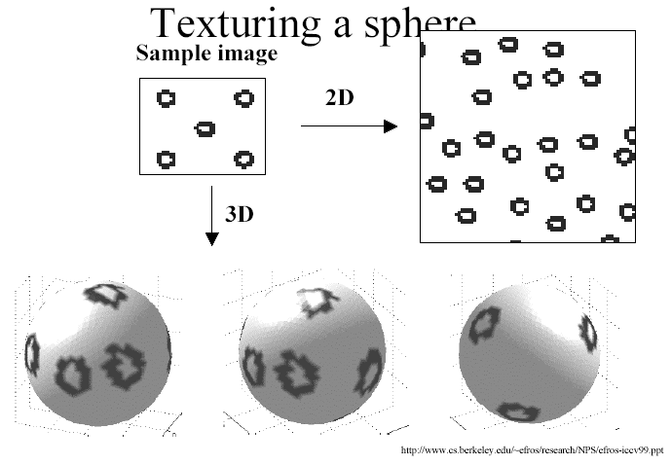

Slide 32
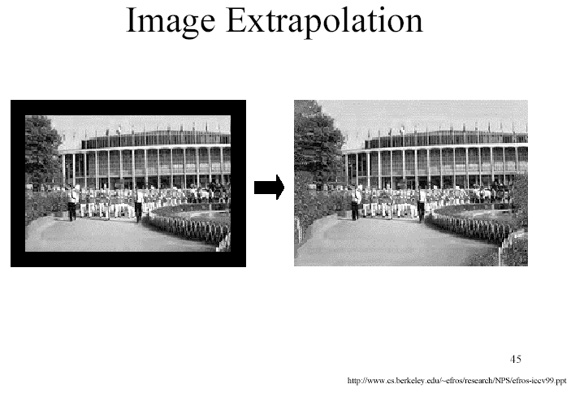

Slide 33
Further issues in texture synthesis
How to improve efficiency
Use fast nearest-neighbor search
How to select region size automatically
How to edit textures to modify them in natural ways

